Slide 1


Christ Confronts the Woman
at the Well
Lesson 11
John 4:1-42

Slide 2
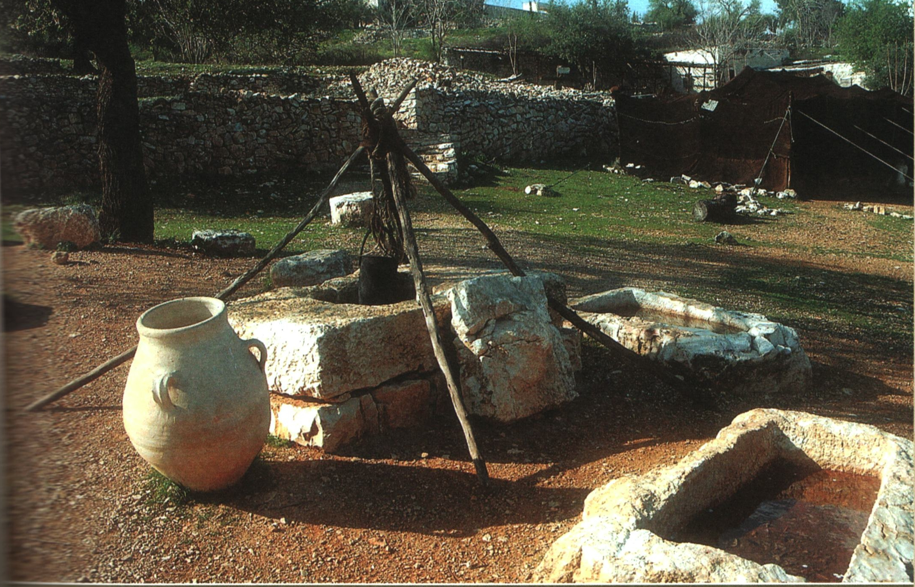

Slide 3
Christ Confronts the Woman
at the Well
1. The Occasion: Jesus Departed from
Judea vv1-3
2. The Place and the People v 4
A. Between Judea and Galilee

Slide 4
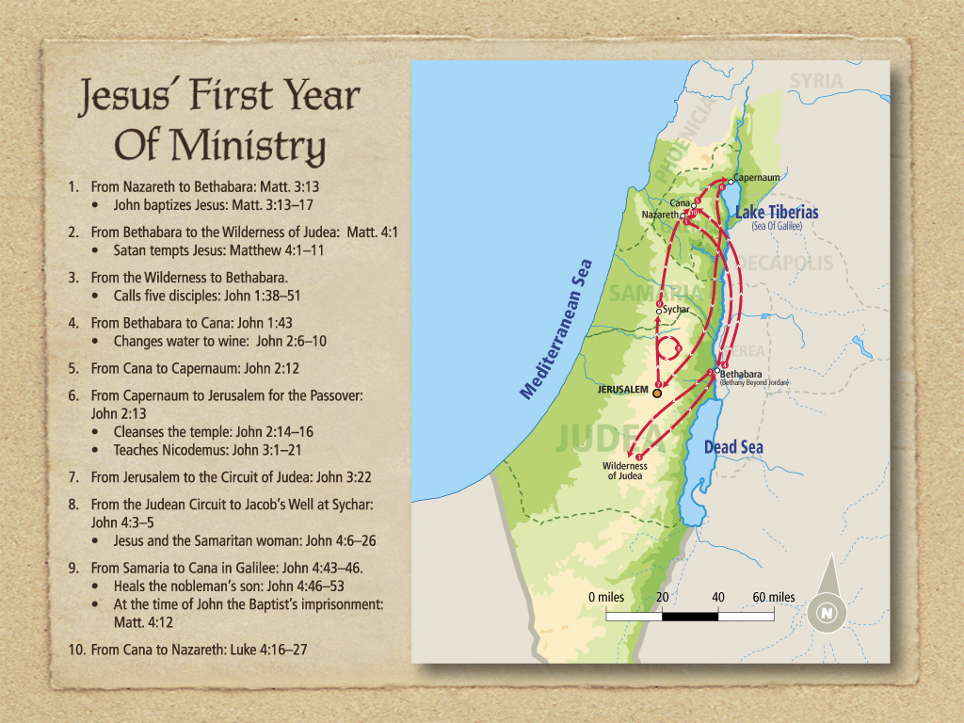
Next week,
Christ ministers in Samaria and Cana

Slide 5
Christ Confronts the Woman
at the Well
1. The Occasion: Jesus Departed from
Judea vv1-3
2. The Place and the People v 4
A. Between Judea and Galilee
B. Populated by “half-breeds” with a heathen core
C. Looked upon with disgust and disdain

Slide 6
3. The Lord
A. His humanity vv6, 9
1. Christ grew weary v6
2. Christ looked like any other Jew v9
B. His deity vv14-18, 25-26, 32
1. He offered eternal life v14
2. He was omniscient vv16-18
3. He claimed deity vv25-26
4. He was sustained by spiritual food v32

Slide 7
C. His dedication and urgency to do God's will vv34-35
D. His concern for His disciples vv35-38

Slide 8
4. Conclusions
A. Lessons abut evangelism
1. He aroused her curiosity v7
2. He made her face her needs vv13-15
3. He made her see her sin vv16-18
B. Lessons about salvation v14
1. Salvation is a gift
2. Salvation brings everlasting life
3. Salvation is for whoever will believe
4. Salvation is not related to ethnicity, background, wealth or intellect.

Slide 9
Next week,
Christ ministers in Samaria and Cana

